Slide 1













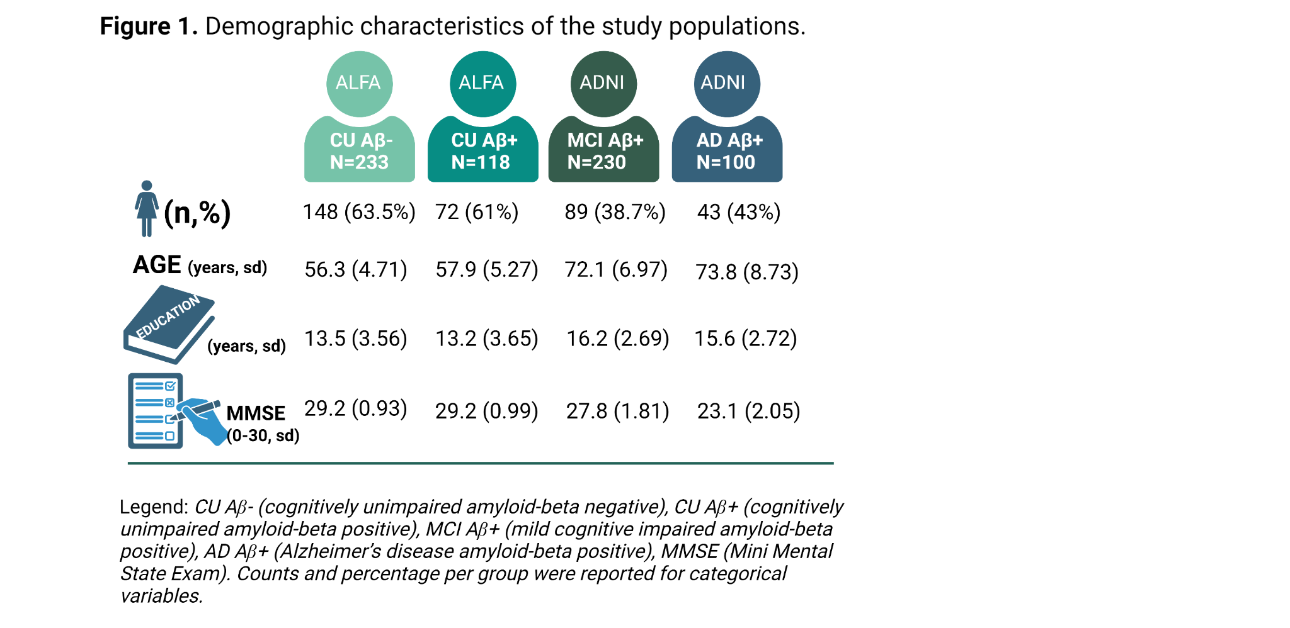
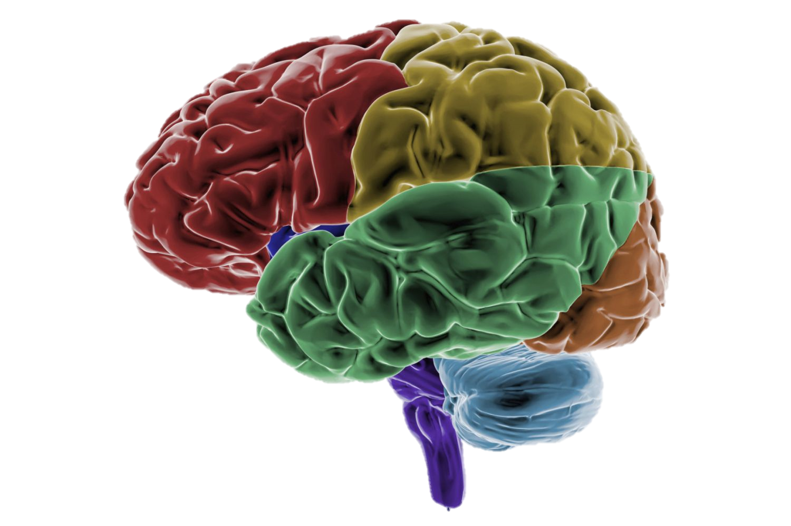
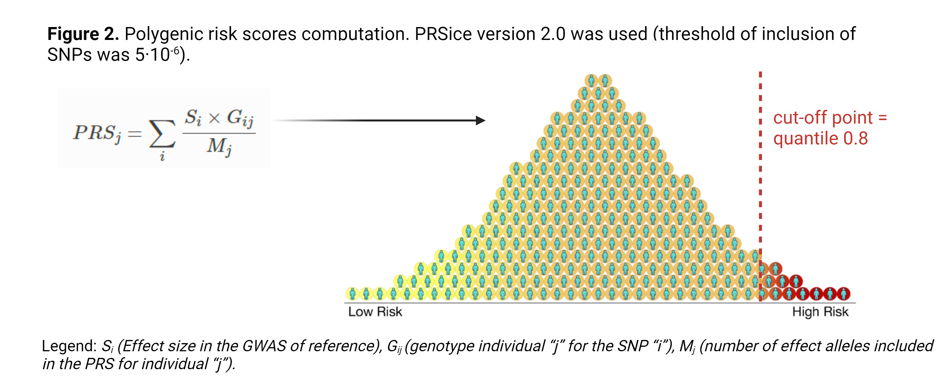
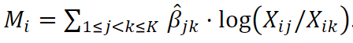
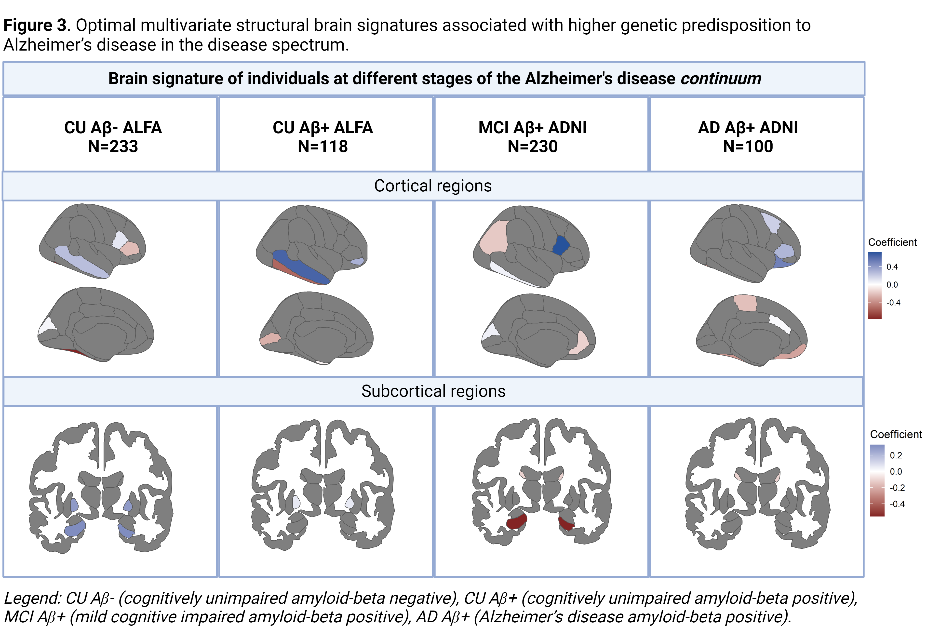
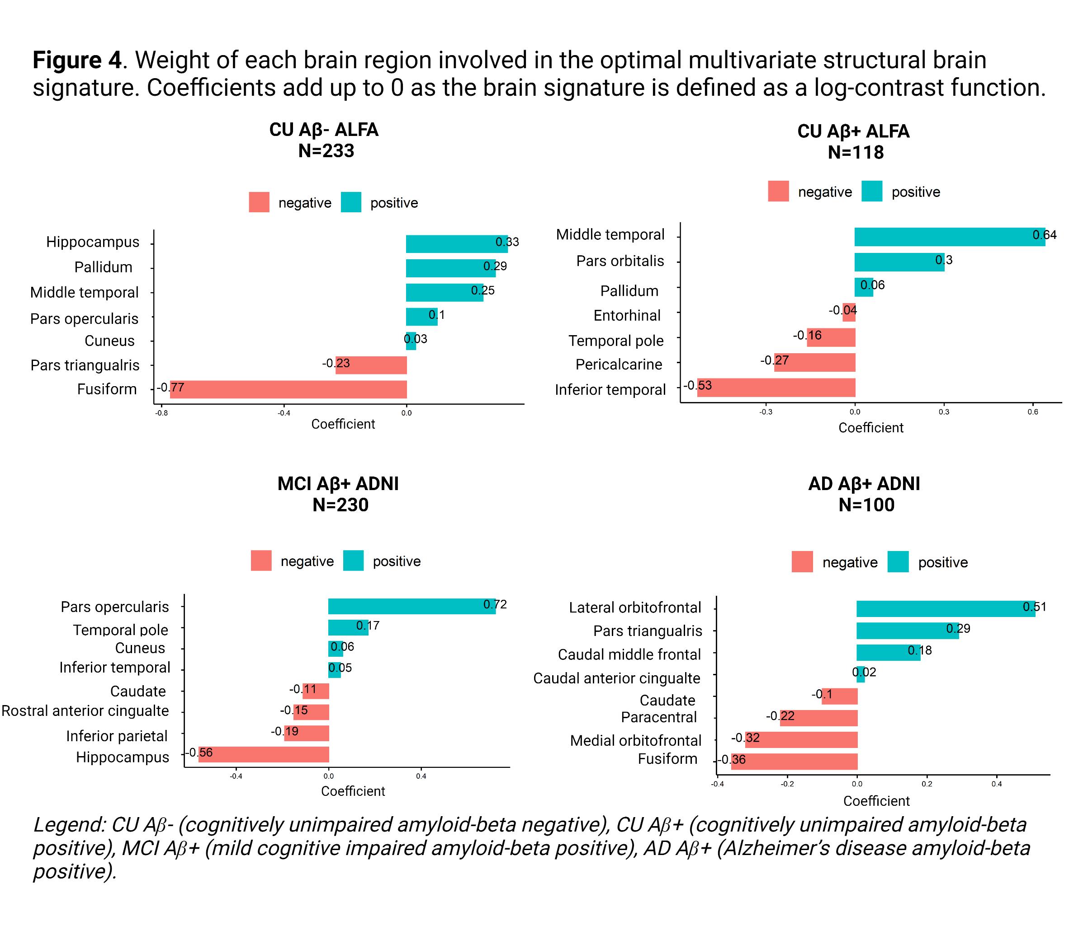
pgenius@barcelonabeta.org patricia.genius@uvic.cat
@pati_genius6
Genetic predisposition to Alzheimer’s disease is differentially associated with joint volumetric variations in the disease continuum
Patricia Genius Serra¹, Malu Calle, Raffaelle Cacciaglia, Carles Falcón, Carolina Minguillón, Manel Esteller, Arcadi Navarro, Juan Domingo Gispert, Natalia Vilor-Tejedor and for the ALFA study
¹Barcelonaβeta Brain Research Center (BBRC), Pasqual Maragall Foundation, Barcelona, Spain
Background
Aim
Imaging genetics (IG) studies analyze how genetic information influences brain features by combining neuroimaging-based brain features and genetics data.
Most IG studies focus on individual analysis of brain structures.
An alternative is to incorporate compositional data analysis (CoDA) methods to assess the joint modulation of specific brain subregions.
The main goal of this study is to explore the structural variation of the brain at different stages of Alzheimer’s disease (AD) continuum, depending on the genetic predisposition to AD.
Methods
a) Sample: cognitively unimpaired (CU) middle-age participants from ALFA [1] and cognitively impaired participants from ADNI [2] study
c) Neuroimaging data
Freesurfer [4] was used to obtain cortical and subcortical parcellations using the Desikan-Killiany atlas [5].
Volumes were globally quantified by summing the measurements of both hemispheres.
d) Statistical Analysis: Statistical analysis was based on CoDA [6]. Analyses were performed using Coda4microbiome R package [7].
Composition: vector of strictly positive real numbers with a constraint or non-informative total sum [8]. In the study, the composition is defined as the whole brain volume, and the components are the brain subregions volumes.
Composition x= [X₁, …, X_{D}] ∈ R^{D}
for x_{i} > 0, ∑^{D}_{i=1} x_{i}=k, where k is a constant
b) Genetic data: The polygenic risk score estimating each participant's genetic predisposition to AD (PRS-AD) was calculated including genetic variants at the genome-wide suggestive level (5·10⁻⁶), normalizing by the total number of alleles [3]. Individuals were classified into high/low genetic predisposition groups (cut-off point=quantile 0.8) [Figure 2].
Key point: the value of each component is not informative by itself and the relevant information is contained in the ratios between parts. The simplest scale invariant function is the log-ratio between components
Coda4microbiome: the algorithm was based on two main steps.
Computation of the optimal multivariate brain structural variation signature (M_{i}) (elastic net selection).
[7]
Logistic regression model to determine the association between the M_{i} and the risk of AD. Models were stratified by disease stage and adjusted for age and sex.
Results
Individuals at different stages on the AD continuum displayed different brain volumetric modulations associated with higher genetic predisposition to AD [Figure 3].
The optimal signature associated with a higher risk of AD was characterized by increased hippocampal volumes in Aꞵ- individuals, but decreased volumes in MCI Aꞵ+ along with the modulation of other temporal regions [Figure 4].
Conclusions
Results showed AD stage-specific multivariate volumetric variation associated with an increased genetic risk of AD.
The analysis of the joint volumetric variation of brain subregions brings an innovative modeling perspective for neurogenetic studies of AD.
References
[1] Molinuevo et al., 2016. Alzheimer’s and Dementia, 2(2).
[2] Petersen et al., 2010. Neurology, 74(3).
[3] Choi & O’Reilly, 2019. GigaScience, 8(7).
[4] Haddad et al., 2022. Human Brain Mapping.
[5] Desikan RS et al., 2006. Neuroimage, 31(3).
[6] Susin et al., 2020. NAR Genomics and Bioinformatics, 2(2).
[7] Calle & Susin, 2022. bioRxiv.
[8] Calle, 2019. Genomics and Informatics, 17(1)

